Slide 1

6.870 Final Project
Webnnel: A channel-based Web navigation system
Chen-Hsiang Yu and Oshani Seneviratne
{chyu,oshani}@mit.edu
May 14, 2008
6.870 Multimodal User Interface

Slide 2

Outline
Introduction (Jones)
Motivations (Jones)
Related Work
  Web automation and customization (Jones)
  Speech recognition (Oshani)
Our Approach
  Web customization and automation (Jones)
  Speech recognition (Oshani)
  The integration of command extension with speech recognizer (Jones, Oshani)
Demonstration
Challenges (Oshani) & Future Work (Jones)
Discussion (Jones)
References
May 14, 2008
6.870 Multimodal User Interface

Slide 3
Introduction
The Web has become an important medium for delivering information.
  Checking e-mails
  Reading news
  Watching videos
  Listening to music
  Shopping on the Web
  . . .
People are familiar with using the Web, and start to apply similar experience to different domains.
  Mobile browsing
  Browsing on different Wi-Fi enabled devices
  . . .
May 14, 2008
6.870 Multimodal User Interface

Slide 4
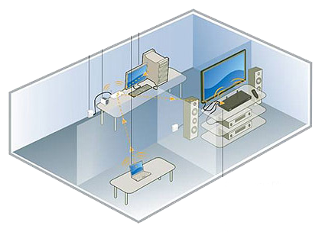
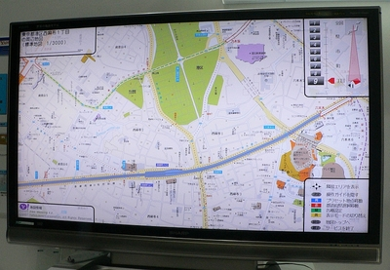
Motivations
However, we spend more than 50% of our time at home.
In this project, we envision an application of Web browsing for home environment.
On the other hand, in the near future, you will watch your TV programs along with browse the Web and use Web applications.
Access and enjoy your digital entertainment easily on your TV and HDTV
May 14, 2008
6.870 Multimodal User Interface

Slide 5
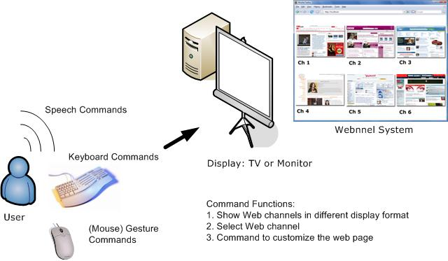
Motivations (cont.)
We propose to use speech and gesture (mouse) to assist Web browsing at home environment.
Figure 1: The concept of the Web channel (webnnel) system.
May 14, 2008
6.870 Multimodal User Interface

Slide 6
Related Work
Web automation and customization
  End-user programming for automation and customization on the Web
    Chickenfoot (Bolin et al. [X])
    GreaseMonkey (Boodman [X], Pilgrim [X])
    WBI (Barrett et al. [X])
May 14, 2008
6.870 Multimodal User Interface

Slide 7
Related Work (Cont.)
  Pre-defined tool-based customization
    Web Developer (Chris Pederick [X])
    Platypus (Scott R. Turner [X])
May 14, 2008
6.870 Multimodal User Interface

Slide 8
Our Approach
Webnnel system is composed of three sub-systems
  Webnnel command system
  Speech Recognition system
  (Mouse) Gesture Recognition system
Because Web content is easier to access and control by the browser extension, we design our Webnnel command system as a Firefox extension.
All the modalities, such as speech, gesture tracking, head tracking can use Webnnel command system.
May 14, 2008
6.870 Multimodal User Interface

Slide 9
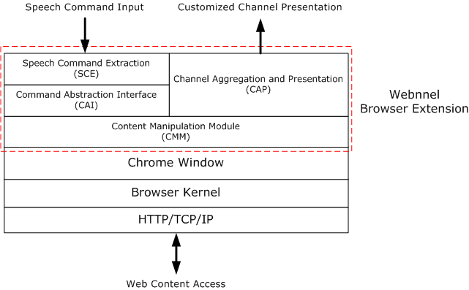
Our Approach (Cont.)
Figure 2: The system architecture of the Web channel (webnnel) system.
May 14, 2008
6.870 Multimodal User Interface

Slide 10
Demonstration
Webnnel Speech Recognition
Webnnel Command System
(Mouse) Gesture Recognition
May 14, 2008
6.870 Multimodal User Interface

Slide 11
Future Work
Enhance the UI of Webnnel Command System
  Add / Delete Web channels
  Add / Delete / Modify E-mail account information
Integrate other modality input, such as hand gesture and head gesture.
Conduct user study to know the feedback from the user.
May 14, 2008
6.870 Multimodal User Interface

Slide 12
Discussion
Why command system works?
Speech recognition
Interface between different application and the browser
Mouse gesture recognition
May 14, 2008
6.870 Multimodal User Interface

Slide 13
References
Avot mV, http://www.avotmedia.com/
Bigham, J. P., and Ladner, R. E. Accessmonkey: a collaborative scripting framework for web users and developers. In W4A '07, ACM Press, pp. 25-34, 2007.
Bolin, M., Webber, M., Rha, P., Wilson, T. and Miller, R.C. Automation and customization of rendered web pages, Proceedings of the 18th annual ACM symposium on User interface software and technology, October 23-26, 2005.
CMU-Sphinx Speech Recognition Engine, http://cmusphinx.sourceforge.net/html/cmusphinx.php
Greasemonkey, https://addons.mozilla.org/en-US/firefox/addon/748
Joost, http://www.joost.com/
Microsoft Windows Vista Speech Recognition system http://www.microsoft.com/enable/products/windowsvista/speech.aspx
Mogulus, http://www.mogulus.com/
Petrie, H., Hamilton, F. and King, N. Tension, what tension? Website accessibility and visual design. Proceedings of the 2004 international cross-disciplinaryworkshop on Web accessibility (W4A), pp. 13-18, 2004.
May 14, 2008
6.870 Multimodal User Interface

Slide 14
References (cont.)
Richards, J. and Hanson, V. Web accessibility: a broader view. Proceedings of the 13th international conference on World Wide Web, pp. 72-79, 2004.
May 14, 2008
6.870 Multimodal User Interface

